Slide 1
the immigrant/millennial link:
[demographic keys for effective church multiplication in a secular age] with jessica udall

Slide 2
in 2018
problem: information overload
action—not talk—is noticed
most compassionate = most persuasive

Slide 3
As the North American Church struggles against marginalization, she would do well to take this reality—that actions speak louder than words, especially in our current context—to heart. Her engagement with the wider secular world should be characterized by radical compassion towards the vulnerable. Not only is this strategic in terms of gaining favor in the eyes of unbelievers who may yet become part of the Church, but it is the very heart and core of the Gospel of our Savior, who demonstrated his concern for the vulnerable—outsiders, the poor, widows, the sick—throughout his ministry on earth, and commands his followers to do the same. –p. 1

Slide 4
Refugees and other immigrants are top-of-mind in secular America today in a way they have not been in decades past. Because immigration very much a part of our national consciousness in 2018, the Church’s wise engagement with the issue is necessary, as disengagement is itself a statement. The world is watching how the Church is responding to vulnerable strangers. – p. 2

Slide 5
“I understand there are political questions at work here. But I also understand that as a representative of the Gospel of Jesus Christ, I have a different set of questions than people who work for the government have....My question is, ‘What is God doing in this?’ And what is the responsibility of the person who knows God to the situation that is right there in front of him?’” – J.D. Greear

Slide 6
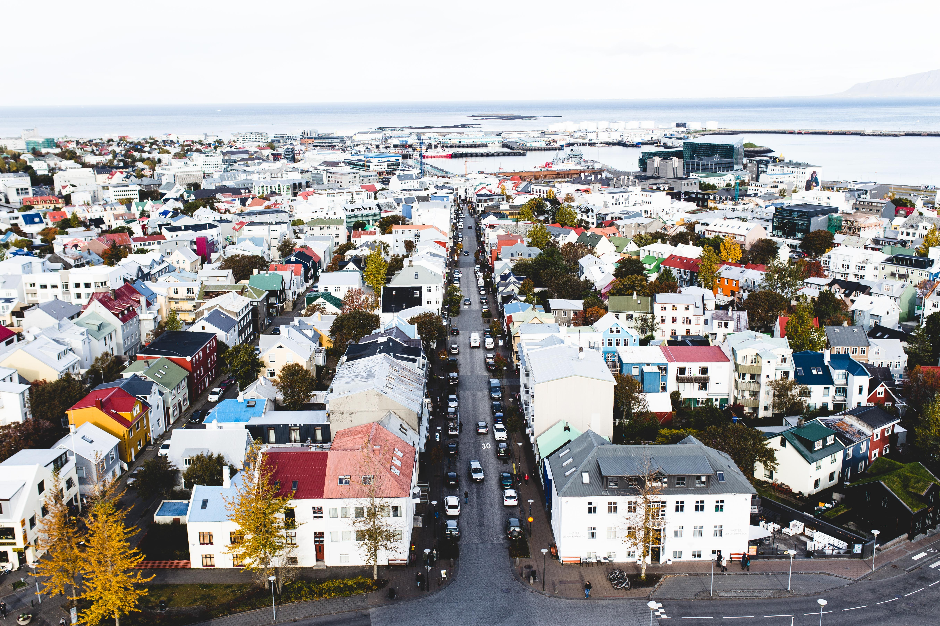
our task? neighbor-love

Slide 7
When returning to the simplicity of Jesus’ commands to love God and love others and when recalling his radically outsider-oriented answer to the question, “Who is my neighbor?” (Luke 10:25-37 [NIV]), it is possible to reach an action-oriented clarity and unity that is more difficult to achieve when debating philosophical stances or potential legislation. – p. 2

Slide 8

gospel proclamation put aside? by no means!

Slide 9
Indeed, in contemporary America, quiet compassion is the very currency that earns a Christian a hearing that he or she otherwise would not have. – p. 3

Slide 10
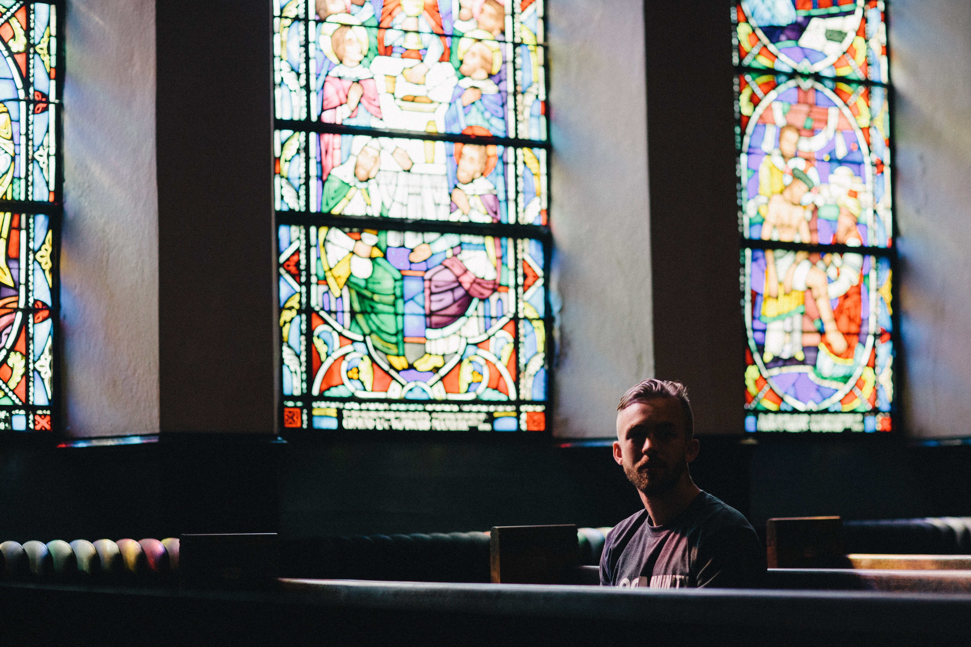
what attracts secularly-oriented Americans to a church?
what the church does > what the church says

Slide 11
how to be effective in compassionate mission in a secular culture? consider 2 demographic trends…
shift towards increasing ethnic diversity
growth of the Millennial generation to be the largest generation alive today

Slide 12

seemingly unrelated, but there are strategic links of similarity…
which should encourage the church to focus on reaching both immigrants and Millennials concurrently in order to experience synergistic multiplication of both groups as church members.

Slide 13
A biblically-rooted, demographically conscious twin focus on welcoming immigrants and welcoming young people will, with God’s help, yield high dividends even in a secularizing atmosphere. – p. 3

Slide 14
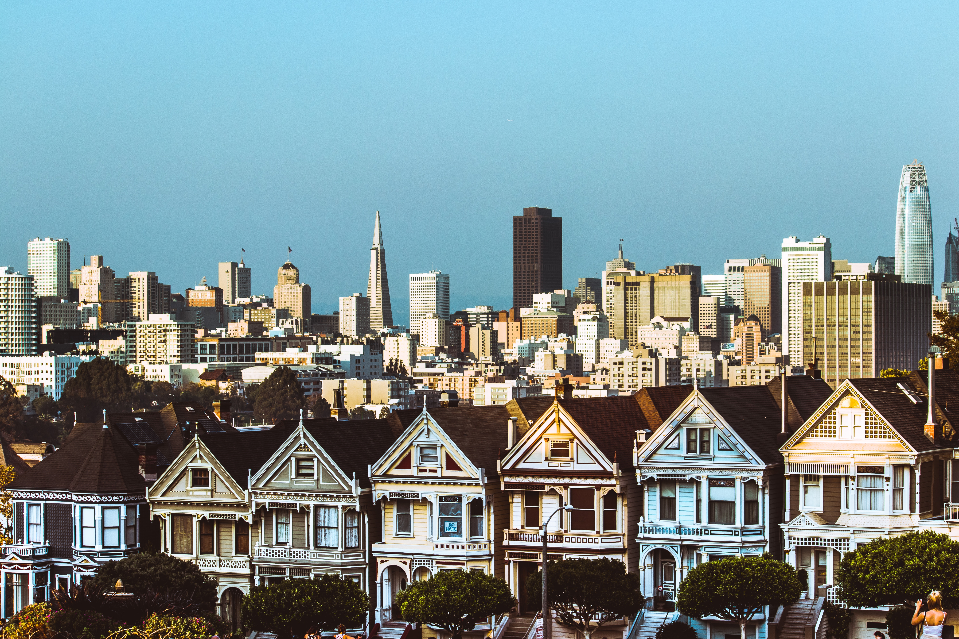
strategic links of similarity:

Slide 15
both groups are best reached through personal friendships with church members.
1

Slide 16
both groups tend to be relationally oriented.
2

Slide 17
both groups long to feel a sense of belonging and community, and respond well to an atmosphere of hospitality.
3

Slide 18
both groups tend to prioritize showing practical compassion to those in need and are willing to personally invest themselves in it.
4

Slide 19
often, an individual can belong to both of these groups at the same time.
5

Slide 20
mutual benefits in the church
(believing) millenials
are in a good position to naturally and warmly welcome those who come from different cultures into the church family.
(believing) immigrants
may be able to gain a more open audience to share truth with diversity-respecting young people than would biblically orthodox Americans.

Slide 21
suggestions
for effective church multiplication based upon the immigrant/millennial link

Slide 22
focus on welcoming those currently on the fringes in the church.
1

Slide 23
focus on creating the margin that facilitates relationships.
2

Slide 24
focus on age integration where possible.
3

Slide 25
focus on empowerment.
4

Slide 26
focus on being excellent outwardly-focused neighbors.
5

Slide 27

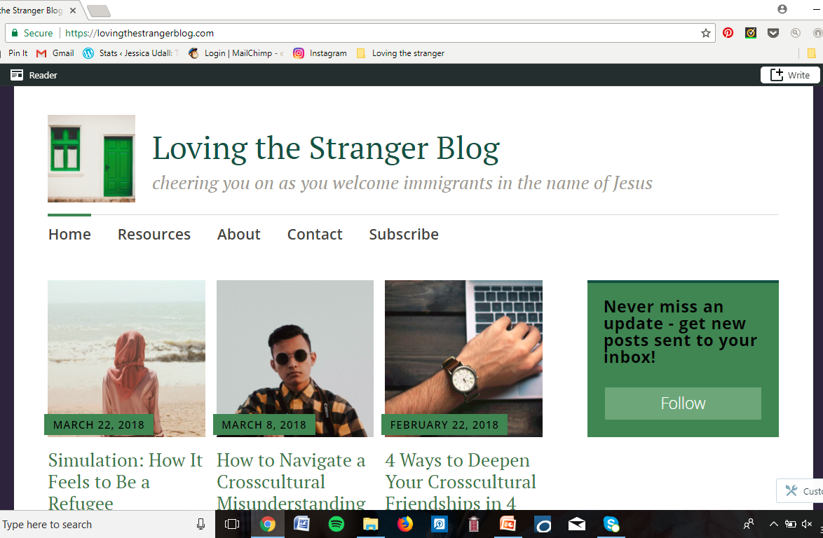

LET’S CONNECT
Book: Loving the Stranger
lovingthestrangerblog.com
@loveimmigrants
lovingthestranger@gmail.com
(template courtesy of slidescarnival)

